Slide 1
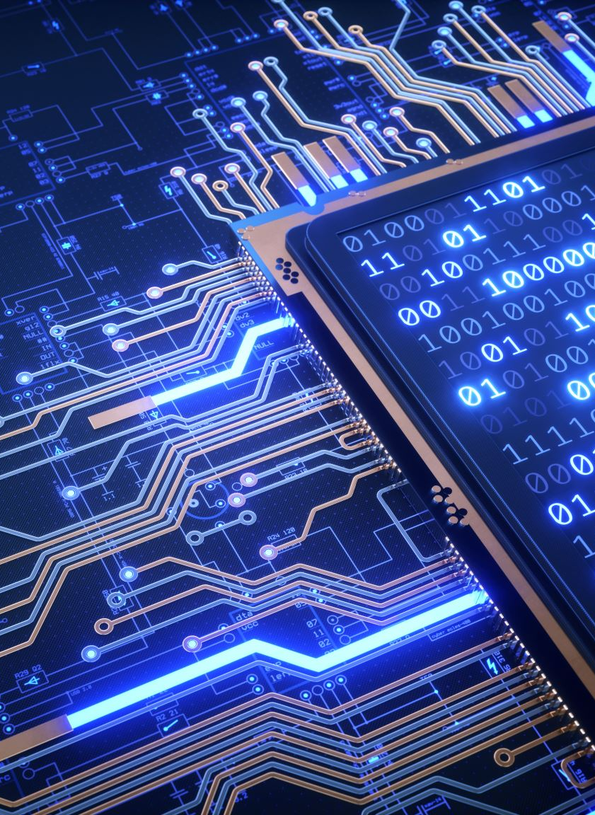
Name = Dev kumar B.Tech (Information Technology),IT-A1 CRN = 2021024 URN = 2004902
Programming for problem solving(ESC- 104)

Slide 2

Q1. Differentiate between call by value and call by reference using suitable examples. Ans. In C language when there is call by reference the address of variable is passed to function call as actual parameter whereas in call by reference actual arguments are created in the same memory location. Q2. Explain the following: 1. Multidimensional array 2. String manipulation function in c. Ans. A. A . Multidimensional array is an array with more then two dimensions. For example in a matrix we have more than two dimensions rows and columns. B. String manipulation refers to the process of handling and analyzing things. All these string functions are handled with header file string.h.

Slide 3
Q3. Define an array with an example. Ans. Array is a collection of similar type of data stored at contiguous memory locations. Example we have to store data of 30 students we can create an array of string type that can store 30 names. More examples as array of juice trays etc. defined4. What are functions? Write a program in C to show the working of user function. Ans. A function is a group of statement that perform specifics task. Example of user defined functions : #include <stdio.h> void dev(); // function prototype declaration. int main() { dev(); printf("Hello World"); //function call return 0; } void dev() //function definition { printf("Welcome to my world\n") ;}

Slide 4
Q1. write a program to print pascal triangle in 1-D array.
#include <stdio.h> //pascal triangle using arrays int main() { int array[30], temp[30], i, j, k, l, num; printf("Enter the number of lines to be printed: "); scanf("%d", &num); temp[0] = 1; array[0] = 1; for (j = 0; j < num; j++) printf(" "); printf(" 1\n"); for (i = 1; i < num; i++) { for (j = 0; j < i; j++) printf(" "); for (k = 1; k < num; k++)
{ array[k] = temp[k - 1] + temp[k]; } array[i] = 1; for (l = 0; l <= i; l++) { printf("%3d", array[l]); temp[l] = array[l]; } printf("\n"); } return 0; }

Slide 5
Bi;

